Slide 1



University Institute of Engineering
DEPARTMENT OF COMPUTER SCIENCE & ENGINEERING
Subject Name: Software Engineering
Subject Code: 23CST-206
User Interface Design
Er. Jagmeet Kaur
E8387
ASSISTANT PROFESSOR
CSE
DISCOVER . LEARN . EMPOWER

Slide 2
Chapter-4 User Interface Design
Command language user interface
Menu based ,Direct manipulation interfaces

Slide 3
Types of User Interface
UI is broadly divided into the following categories:
Command Line Interface
Graphical User Interface
Menu based UI
Direct Manipulation Interface

Slide 4
Command Line Interface (CLI)
A Command Line Interface (CLI) is a type of user interface where users interact with a computer or software by typing text-based commands. Unlike graphical user interfaces (GUIs), CLIs rely on keyboard input and do not use icons, buttons, or windows.

Slide 5
Examples of CLI Applications
Operating System Shells
Windows Command Prompt (cmd.exe)
PowerShell (for advanced Windows scripting)
Linux Terminal (bash, zsh, fish)
macOS Terminal (uses Unix-based shell like zsh or bash)
Programming and Development
Git (git commit -m "message") for version control.
Python, Node.js, Java compilers (e.g., python script.py, javac HelloWorld.java).
Database Management
MySQL, PostgreSQL, MongoDB (e.g., mysql -u root -p, psql -d mydatabase).
Networking and System Administration
Ping and Traceroute (ping google.com, tracert 8.8.8.8).
SSH for remote access (ssh user@server.com).
File operations (mv, cp, rm, mkdir).

Slide 6
Advantages of CLI
✔ Efficient for power users – Faster than navigating a GUI. ✔ Low resource consumption – Runs on minimal hardware. ✔ Highly flexible – Supports scripting and automation. ✔ Remote Access – Used for managing servers and networks.
Disadvantages of CLI
❌ Steep learning curve – Requires memorization of commands. ❌ Error-prone – A single typo can cause unintended actions. ❌ Not user-friendly – Difficult for beginners compared to GUI.

Slide 7
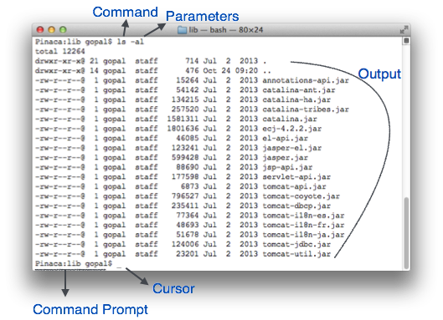
CLI Elements

Slide 8
CLI Elements
A text-based command line interface can have the following elements:
Command Prompt - It is text-based notifier that is mostly shows the context in which the user is working. It is generated by the software system.
Cursor - It is a small horizontal line or a vertical bar of the height of line, to represent position of character while typing. Cursor is mostly found in blinking state. It moves as the user writes or deletes something.
Command - A command is an executable instruction. It may have one or more parameters. Output on command execution is shown inline on the screen. When output is produced, command prompt is displayed on the next line.

Slide 9
Graphical User Interface
A Graphical User Interface (GUI) is a type of user interface that allows users to interact with a system using visual elements such as windows, icons, buttons, and menus instead of text-based commands. It is designed to be intuitive and user-friendly, making computers accessible to people with little technical knowledge.

Slide 10
Examples of GUI-Based Systems
Operating Systems
Microsoft Windows (Start menu, taskbar, icons)
macOS (Dock, Finder, menu bar)
Linux (Ubuntu, Fedora, etc.) (GNOME, KDE environments)
Software Applications
Microsoft Office Suite (Word, Excel, PowerPoint)
Adobe Photoshop (Toolbars, color palettes)
Web Browsers (Google Chrome, Mozilla Firefox, Safari)
Mobile Operating Systems
Android (App icons, notification bar)
iOS (Home screen, control center, gestures)

Slide 11
Advantages of GUI
✔ User-Friendly – Easy to learn and use, even for beginners. ✔ Visual and Interactive – Enhances user experience with graphics and animations. ✔ Multitasking – Allows users to open and manage multiple applications simultaneously. ✔ Minimal Memorization – No need to remember complex commands like in CLI.
Disadvantages of GUI
❌ Resource-Intensive – Requires more memory and processing power compared to CLI. ❌ Slower for Advanced Users – Some tasks can be done faster using command-line interfaces. ❌ Limited Customization – Not as flexible as scripting in CLI for automation and complex tasks.

Slide 12
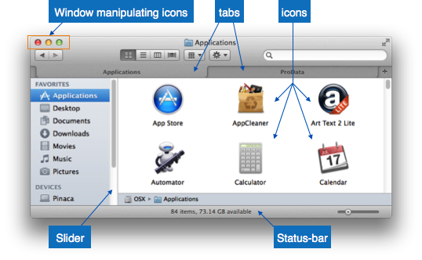
GUI Elements

Slide 13
GUI Elements
Tabs - If an application allows executing multiple instances of itself, they appear on the screen as separate windows. Tabbed Document Interface has come up to open multiple documents in the same window. This interface also helps in viewing preference panel in application. All modern web-browsers use this feature.
Menu - Menu is an array of standard commands, grouped together and placed at a visible place (usually top) inside the application window. The menu can be programmed to appear or hide on mouse clicks.

Slide 14
GUI Elements
Icon - An icon is small picture representing an associated application. When these icons are clicked or double clicked, the application window is opened. Icon displays application and programs installed on a system in the form of small pictures.
Cursor - Interacting devices such as mouse, touch pad, digital pen are represented in GUI as cursors. On screen cursor follows the instructions from hardware in almost real-time. Cursors are also named pointers in GUI systems. They are used to select menus, windows and other application features.

Slide 15
Text-Box - Provides an area for user to type and enter text-based data.
Buttons - They imitate real life buttons and are used to submit inputs to the software.
Radio-button - Displays available options for selection. Only one can be selected among all offered.
Check-box - Functions similar to list-box. When an option is selected, the box is marked as checked. Multiple options represented by check boxes can be selected.
List-box - Provides list of available items for selection. More than one item can be selected.

Slide 16
Menu-Driven Interface
is a type of user interface where users interact with a system by choosing options from menus. It simplifies navigation by presenting a structured list of commands or choices.
An example is the settings menu on your phone. All you can do is scroll the menu and tap items; no other interaction is available. Accordingly, it is used in applications with a familiar, limited, and uniform set of functions. You could put them all under subheadings like “Camera Settings”, “Display Settings”, etc.

Slide 17
Examples of Menu-Based Interfaces
ATMs (Automated Teller Machines)
Users navigate options such as "Withdraw Cash," "Check Balance," or "Deposit Funds" using on-screen buttons or a touchscreen.
Restaurant Self-Ordering Kiosks
Customers select food and drinks from a digital menu displayed on a touchscreen.
Mobile Phone Settings
Smartphones have menu-based interfaces for settings like "Wi-Fi," "Bluetooth," and "Display" options.
Video Game Menus
Games have menus for selecting "Start Game," "Load Game," "Settings," and "Exit."
Software Applications (e.g., Microsoft Word, Excel)
Features like "File," "Edit," "View," and "Tools" are organized in a menu for easy access.

Slide 18
Advantages of a Menu-Driven Interface
Handy for computer beginners and novice users
Familiar interface across different platforms
You are in charge of creating an order and a hierarchy for user pathways
More control over user interactions
Simple to implement in various kinds of devices
Disadvantages of a Menu-Driven Interface
Limited menu options
Sub-menus might be difficult to find
Risks of taking up a lot of screen space or being too small
Requires unnecessary actions for a simple task

Slide 19
A Direct Manipulation Interface (DMI) Direct Manipulation Interface (DMI)
A Direct Manipulation Interface (DMI) allows users to interact directly with objects on the screen rather than using text commands or menu selections. Users perform actions by clicking, dragging, or touching graphical elements.
Examples of Direct Manipulation Interfaces
Graphical Operating Systems (e.g., Windows, macOS)
Dragging and dropping files, resizing windows.
Photo Editing Software (e.g., Photoshop)
Adjusting image properties by dragging sliders.
Touchscreen Interfaces (e.g., smartphones, tablets)
Pinching to zoom, swiping to navigate.
Game Interfaces
Controlling characters using joysticks or on-screen buttons.

Slide 20
Advantages of Direct Manipulation Interfaces
✔️ User-friendly – Easy for beginners to use. ✔️ Efficient – Faster than typing commands. ✔️ Encourages Exploration – Users can try different actions with immediate feedback. ✔️ Reduces Errors – The ability to undo mistakes makes the system more robust.
Disadvantages of Direct Manipulation Interfaces
❌ Resource-Intensive – Requires more processing power and memory than text-based interfaces. ❌ Not Ideal for Complex Tasks – Some advanced operations are harder to perform without command-line precision. ❌ Scalability Issues – Can become cluttered when dealing with large datasets or complex workflows.

Slide 21
References
https://www.tutorialspoint.com/software_engineering/software_user_interface_design.htm
https://www.usability.gov/what-and-why/user-interface-design.html#:~:text=The%20best%20interfaces%20are%20almost,get%20things%20done%20more%20quickly.
https://www.elegantthemes.com/blog/resources/10-rules-of-good-ui-design-to-follow-on-every-web-design-project

Slide 22
THANK YOU

